Slide 1

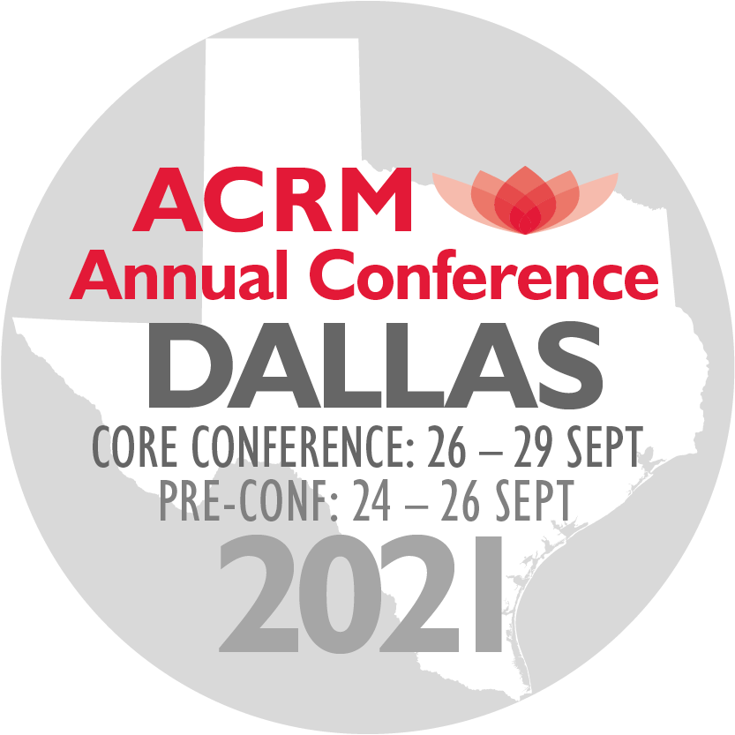
LOOKING AHEAD... SAVE THE DATES
ACRM 98th Annual Conference
DALLAS HILTON ANATOLE
CORE: 26 – 29 SEPTEMBER PRE-CONF: 24 – 26 SEPT
ACRM.org/2021

Slide 2

SAVE THE DATES
ACRM 98th Annual Conference
CORE: 26 – 29 SEPTEMBER PRE-CONF: 24 – 26 SEPT
ACRM SPRING MEETING
19 – 20 MARCH 2021
ACRM.org
HILTON ANATOLE

Slide 3

LOOKING AHEAD...
ACRM 98th Annual Conference
DALLAS HILTON ANATOLE
CORE: 26 – 29 SEPTEMBER PRE-CONF: 24 – 26 SEPT
SAVE THE DATES
Call for Proposals
ACRM.org/call

Slide 4
LOOKING AHEAD... FUTURE ACRM EVENTS
2021
ACRM 98th ANNUAL CONFERENCE — DALLAS Hilton Anatole
26 – 29 September 2021 // Core Conference
24 – 26 September 2021 // Pre-Conference
ACRM SPRING MEETING — DALLAS Hilton Anatole
19 – 20 March 2021 // DALLAS, Texas USA
2022
ACRM 99th ANNUAL CONFERENCE — CHICAGO Hilton
8 – 11 November 2022 // Core Conference
6 – 8 November 2022 // Pre-Conference
ACRM SPRING MEETING — CHICAGO Hilton
Date: TBD 2022 // CHICAGO, Illinois USA
Notes:
(Visual: Pic of logo with tag)
And like the lotus, whose seeds can remain viable for hundreds of years – ACRM plans to continue to thrive and grow and blossom.
Thank you.

Slide 5

Notes:
(Visual: Pic of logo with tag)
And like the lotus, whose seeds can remain viable for hundreds of years – ACRM plans to continue to thrive and grow and blossom.
Thank you.

